Slide 1
Healthy Lifestyle

Slide 2
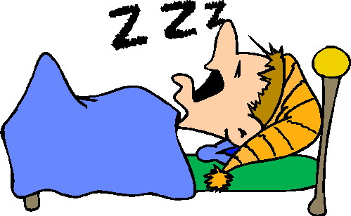
What does a healthy lifestyle consist off?
- Eating healthy
- Daily exercise
- Adequate sleep

Slide 3
What happens if we don’t lead a healthy lifestyle.
High blood pressure.
High cholesterol
Coronary heart disease
Stroke
Diabetes
Obesity

Slide 4
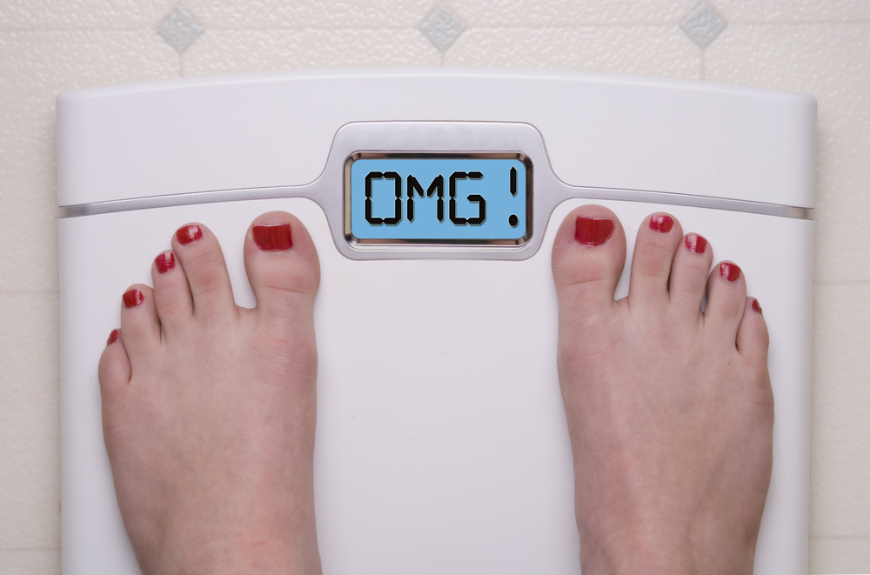
Figures in 2016 show that the UK is the second most obese country in Europe.
19.1% of children in Year 6 (aged 10-11) are obese and a further 14.2% are overweight.
Of children in Reception (aged 4-5), 9.1% are obese and another 12.8% are overweight.

Slide 5
In 2007 estimates of the direct NHS costs of treating overweight and obesity, and related morbidity in England were £4.2 billion.
By 2015 the figures reached £6.3.
An estimated extra £352 million per year is spent by local authorities on providing formal care for severely obese people compared to healthy weight people.

Slide 6
What can we do to lead a healthy lifestyle?
Be active! Exercise!

Slide 7
Hands UP!!!!
All young people should be active for at least 60 minutes each day. Are you?

Slide 8
What counts as being active?
The Government states that children and young people are recommended to do at least 60 minutes of at least moderate intensity exercise every day.
This means activity that will:
make you breathe harder;
make your heart beat faster;
make you feel warmer and sweat.

Slide 9
Think of ways to be active?!
Walk or cycle to school
Walk up the stairs
Play with friends in the park
Go for a run
Help out with housework, e.g. gardening
Take part in P.E. Lessons
Take part in extra curricular clubs
Join a sports club

Slide 10
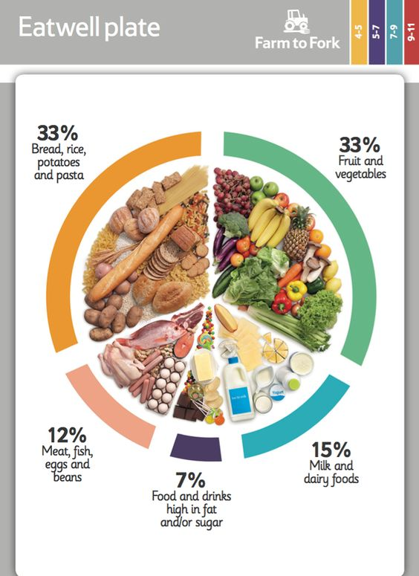
Eating Healthy!

Slide 11
Don’t skip breakfast!
Who had breakfast this morning?
Eating breakfast provides us with energy as well as some important nutrients that we need for good health. Breakfast can help to increase concentration and alertness during the morning. Less likely to fill up on snacks that are high in fat and/or sugar if we get hungry before lunch.

Slide 12
Cut down on saturated fat and sugar!
What are foods high in saturated fat?
What are foods high in sugar?
Eating too much saturated fat can increase blood cholesterol levels and the chance of developing heart disease.
Too many sugar-containing food and drinks consumed between meals is linked with an increased tendency towards tooth decay.

Slide 13
Drink Water! Avoid Fizzy Drinks

Slide 14
To give you a rough idea!

Slide 15
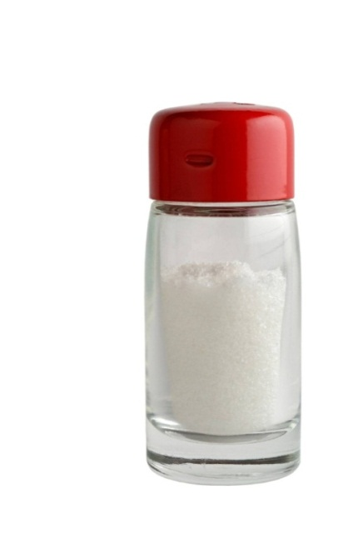
Eat less salt!
Adults and teenagers should eat no more than 6g of salt each day, and children under
11 years need even less.
Maintaining a normal blood pressure is important for health. Eating too much
salt may raise blood pressure and
lead to stroke and heart disease.

Slide 16
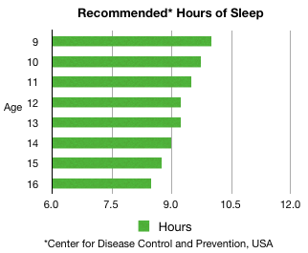
Sleep!!

Slide 17
https://www.youtube.com/watch?v=5T0D_8OwvOk

Slide 18
Mr Malavecis’s Top Tips To A Healthier Lifestyle
Base your meals on starchy foods
Eat lots of fruit and veg
Eat more fish
Cut down on saturated fat and sugar
Eat less salt
Get active
Drink plenty (2 litres a day)
Do not skip a healthy breakfast

